Slide 1

Welcome and Congratulations!
This resource is for teams looking for sponsorship to travel to Global Finals. Read this slide carefully.
Each slide can be personalized by your team.
Under each slide you will find comments that give tips and suggestions on how to modify the slide and how to present the slide in front of a sponsor.
Once you are happy with your presentation content, you can reach out to potential sponsors and request a meeting by email or phone. You can use our letter template to create your email.
Remember that a sponsor will need to understand the benefit they receive from supporting you. Various benefits are included in the comments under the Sponsorship Levels slides. Benefits should promote the sponsor brand in some way (exposure to large numbers of people) or help them reach their CSR goals (promoting STEM education, encouraging teamwork,etc.). Always visit the company website to see what their goals are as a company to align your presentation and benefits.
On the next slide is a short video explaining how to modify and present this Powerpoint.
Once you have finished reading this slide and watching the video on the next slide, right click on the slides and hide them from view.

Slide 2
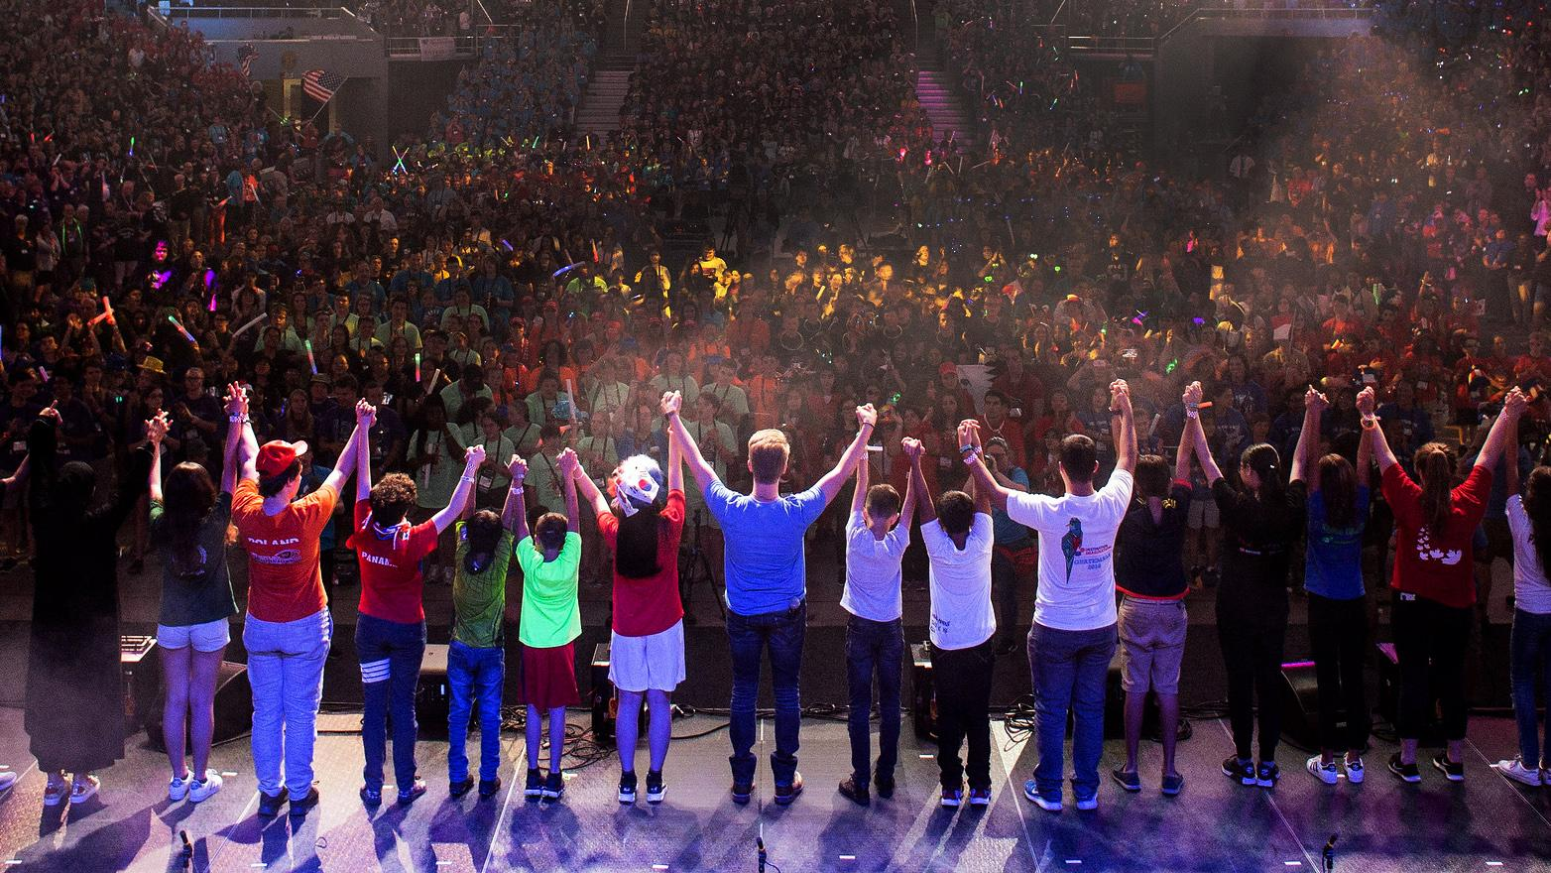

TEAM SPONSOR PROSPECTUS

Slide 3
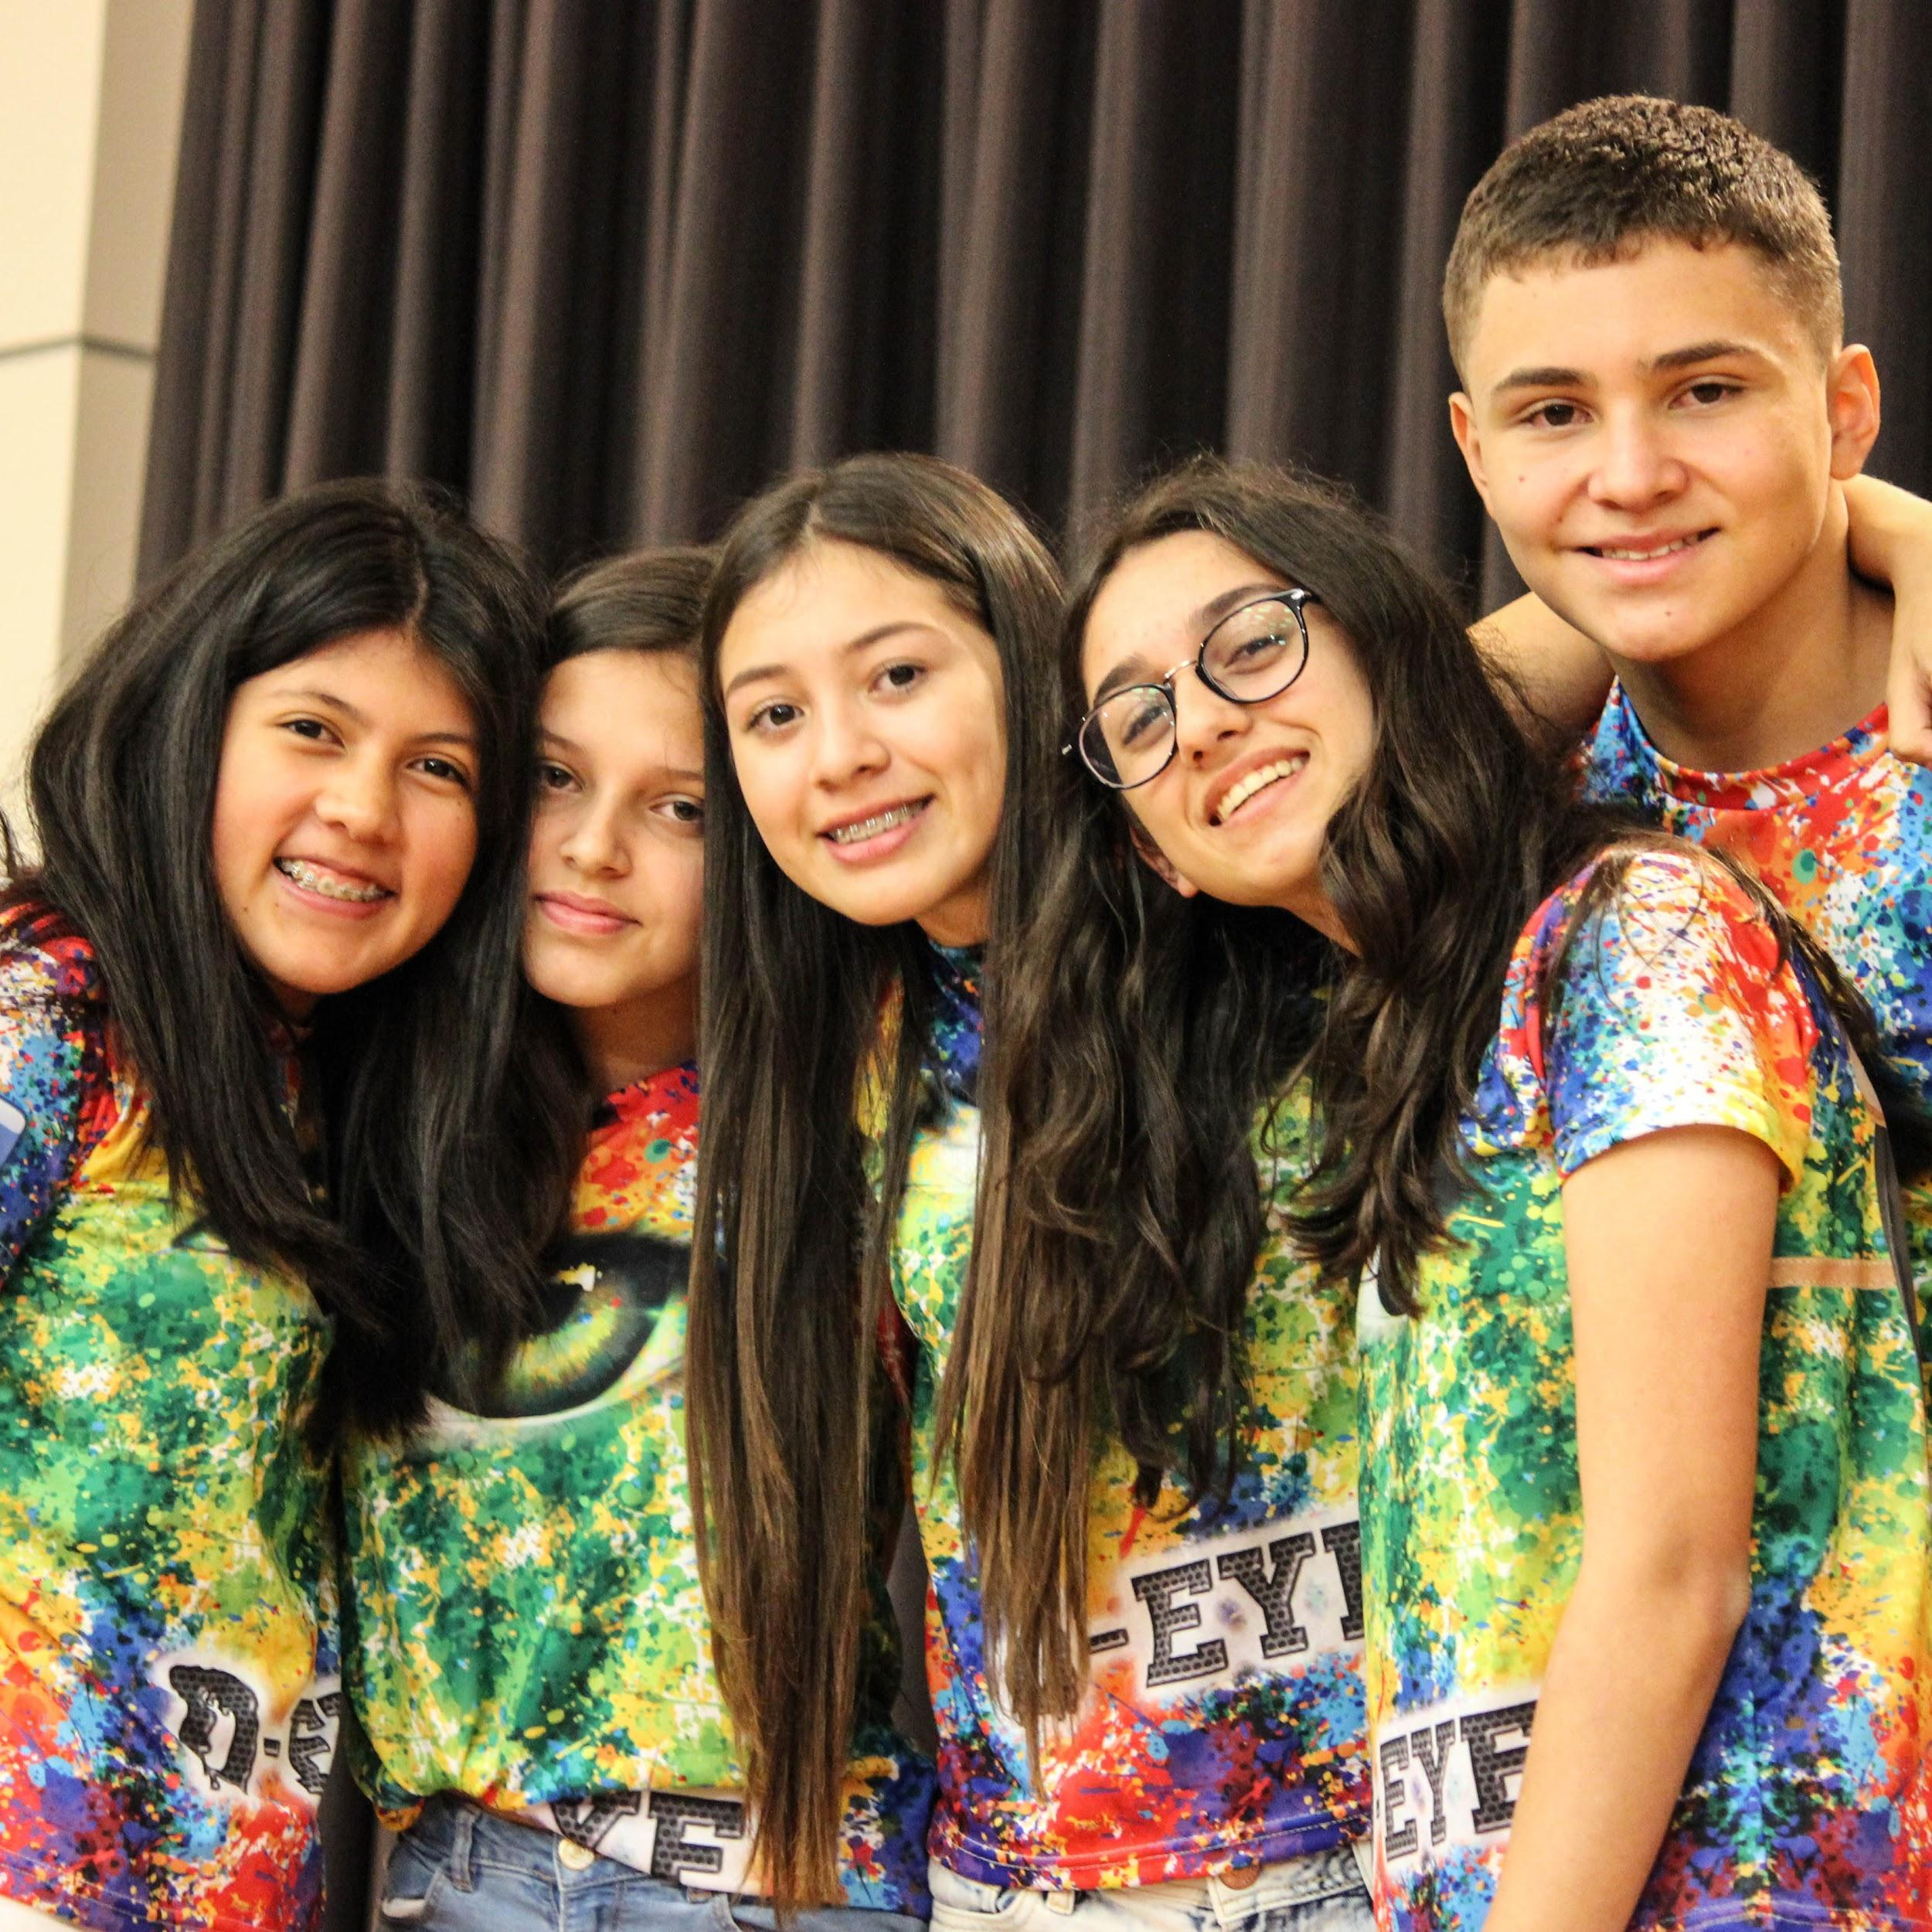

<Your Team Name>
<Your Place at Local Tournament, Challenge, Level>
Notes:
Modify the Slide:
Put in two pictures of your team by clicking the picture and deleting and inserting a new one.
Highlight the <Your Team Name> and type in your team name.
Highlight the <Your Place at Local Tournament, Challenge, Level> and type in your place (First, Second, Third, etc.), your Challenge name, and your competition level (EL, ML, SL, UL)
Tips for presenting this slide:
Introduce your team members using strong communication skills.
State why you are there. (Examples: we want to share our journey, and ask for support from <name of person> or <name of company> for the next competitive level, Global Finals)

Slide 4
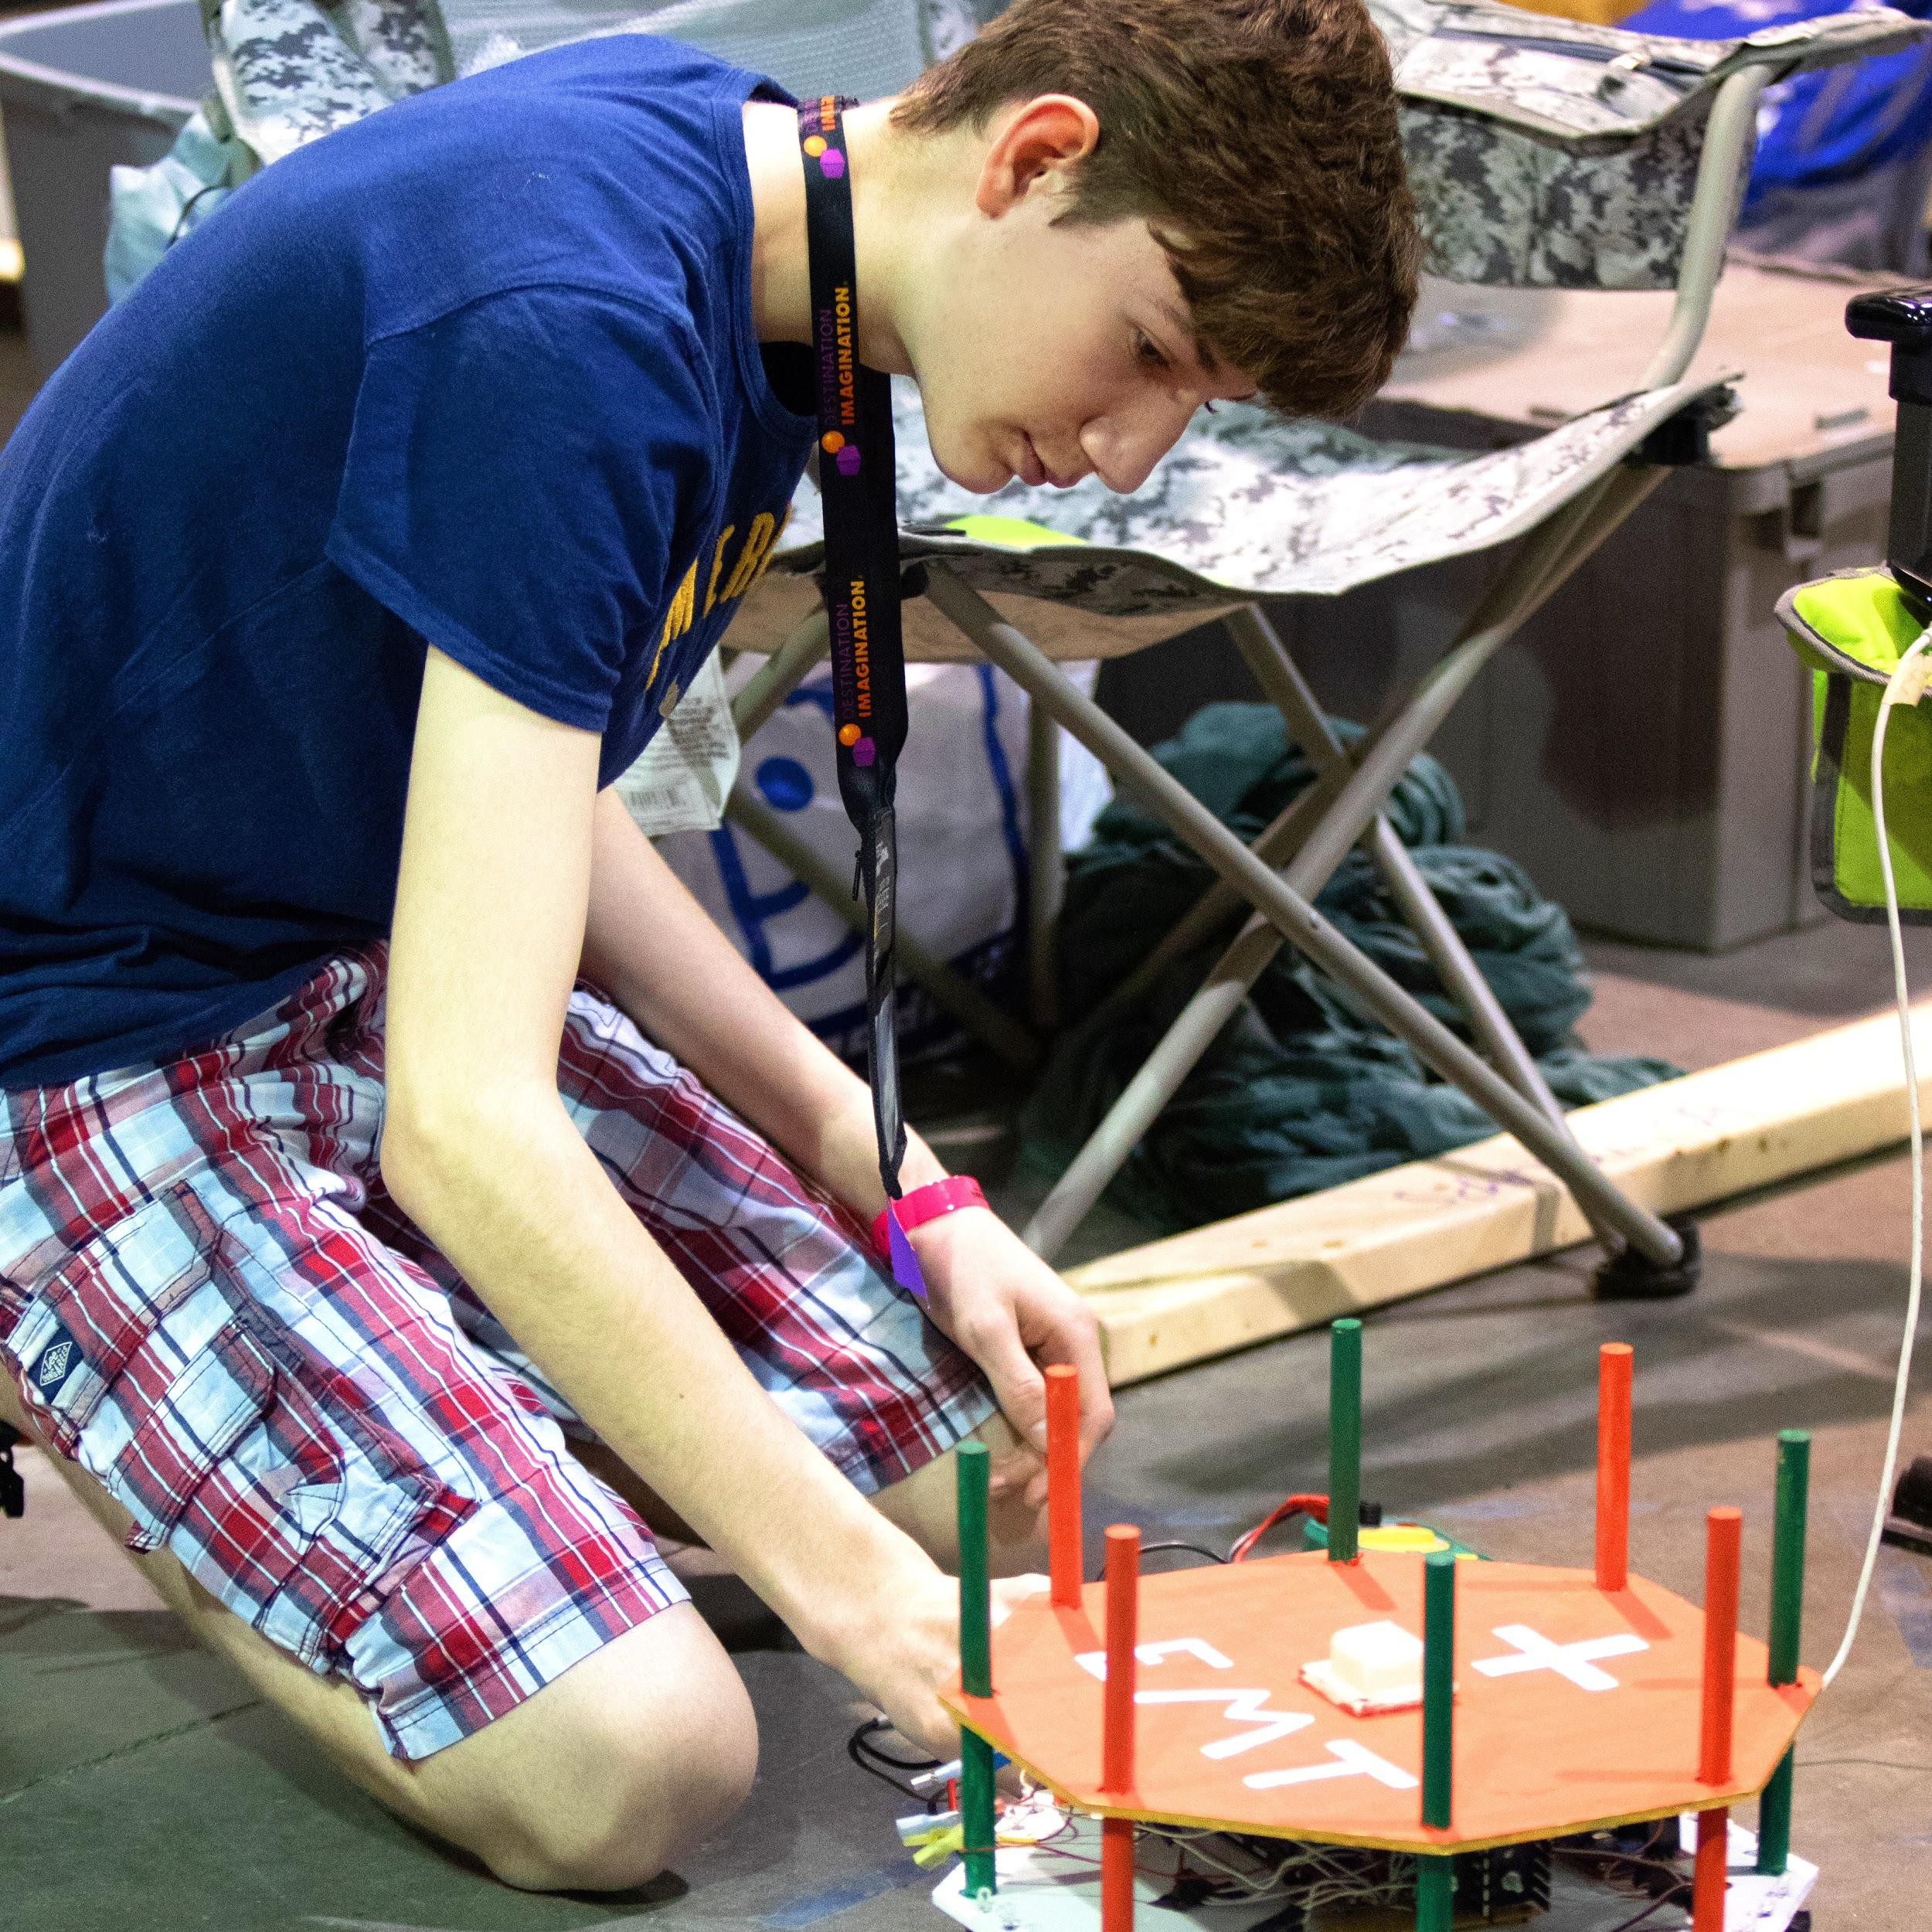
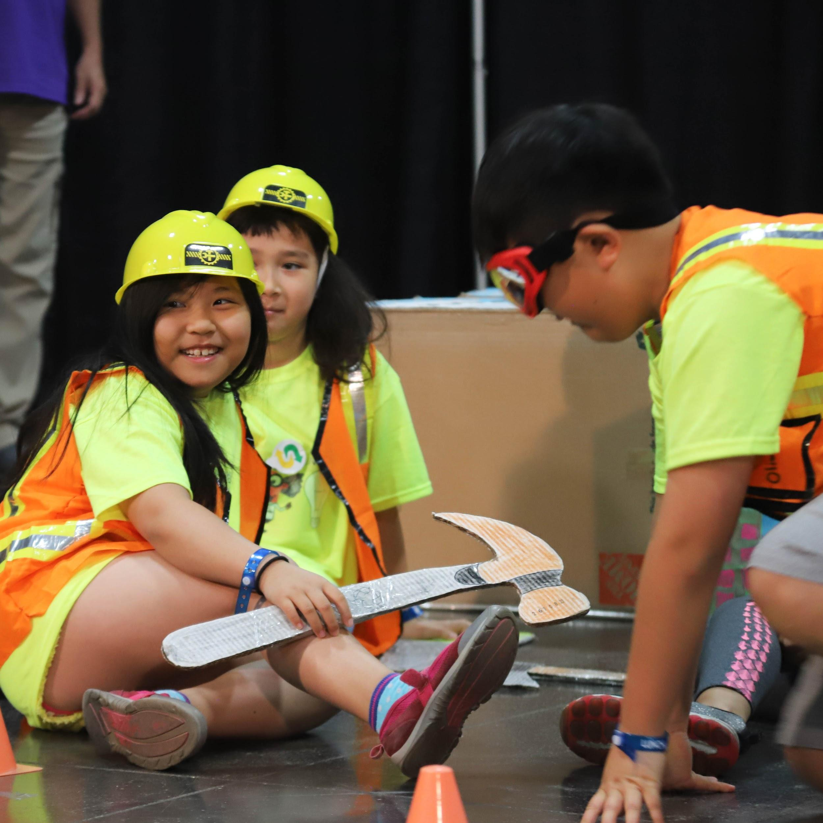
WHY WE DO DI
Vision, Mission, Values
Vision
Inspire and equip participants to achieve anything they can imagine in life
Mission
To engage participants in project-based challenges that are designed to build confidence and develop extraordinary creativity, critical thinking, communication, and teamwork skills
DI Principles
Fun learning: Explore STEM/STEAM concepts in a hands-on environment
Creative problem solving: Learn how to think, not what to think
Kid powered; team driven: Energize students to own all decisions, creations, and results
Friendly competition: Motivate teams to reach for the stars, while also rooting for each other
Global diversity: Encourage and celebrate differences in each other, and differences in ideas
Notes:
Modify the Slide:
None needed
Tips for presenting this slide:
Discuss how you as a team have experienced the mission and vision through your participation by highlighting one or two things on the slide that relate to your DI journey.
Do not read the slide to them.

Slide 5
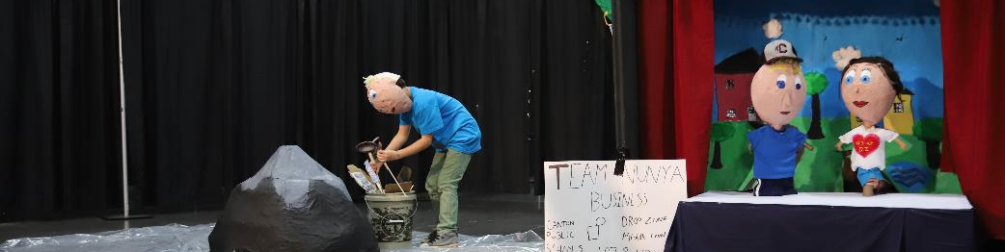

OUR CONTENT
Life-Changing Experiences
Team Challenge Experience
Destination Imagination (DI) annually develops multidisciplinary Team Challenges that are designed as a fun and engaging system of learning.
Gain knowledge and experience in creative and critical thinking, project management, team building, conflict resolution, informed risk-taking, STEAM, perseverance, and a completion mind set.
Each Challenge encourages students to explore their passions, discover their own talents and abilities, and learn new skills.
Global Finals
Each year, teams from around the world qualify for Global Finals, the largest annual celebration of creativity in the world and the culminating event for the DI Challenge Experience.
Teams are top innovators, problem solvers, storytellers, collaborators, critical thinkers, and project managers.
They strengthen their skills and widen their perspective and their appreciation of the similarities and differences in creative and innovative thinking.
Notes:
Modify the Slide:
Replace the Team Challenge Experience photo with one of your team working (optional)
Tips for presenting this slide:
Talk about your Team Challenge Experience highlighting working as a team, choosing your Challenge and going to tournament.
Tell them about the feeling when you heard your team name called as a Global Finals candidate and why you are so excited about going.
Highlight what you hope to experience on this trip—skills you hope to develop and learning from other top teams worldwide so you can gain more knowledge and ideas to bring back to your Affiliate.

Slide 6







PREPARE THE FUTURE WORKFORCE
Why Support Your Local DI Team?
Dedicated to closing the skills gap and preparing learners for a future that is rapidly evolving.
Risk Taking
Problem
Solving Under Pressure
Team Building
Creative &
Critical
Thinking
Perseverance
Project Management
Self-Confidence
The demand for highly-skilled workers will hit 123 million by 2020, but there will only be 50 million qualified people to fill these roles.
– AT&T
65% of today’s students will be employed in jobs that have yet to be invented.
– U.S. Department of Labor
60% of CEOs polled cited creativity as the most important leadership quality, compared with 52% for integrity and 35% for global thinking.
– IBM Global CEO Study
Notes:
Modify the slide:
None needed
Tips for presenting the slide:
Each team member can speak to one of the skills listed and how you have seen it develop on your DI team.

Slide 7






PREPARE THE FUTURE WORKFORCE
Why Send Teams to Global Finals?
Local teams have worked many hours together and earned a spot to attend Global Finals through a meritorious competition structure. They will have the opportunity to:
Communicate and develop diversity awareness skills with peers from more than 24 cultural backgrounds.
Develop resilience at a highly competitive level.
Travel together outside of their home location, exercising important travel skills.
Compete with more than 1,400 finalists from around the world.
Practice problem solving as they encounter new sets of cultural and societal norms in the host country.
Establish lifelong connections with students from around the world.
Notes:
Modify the slide:
None needed
Tips for presenting the slide:
Highlight one or two of the opportunities listed or share additional ones you may have as a team.
Focus on the skills you will gain by attending Global Finals as opposed to the fun things you will do there.

Slide 8
WHAT WE’VE ACCOMPLISHED
Our Challenge Solution
In this season’s Technical Challenge, The Next Level, our team was challenged to:
Create and present a video presentation in the style of a video game.
Include an adventurer who goes on a quest to win an ultimate prize.
Portray a special ability used by the adventurer.
Integrate 3 quest items and combine them to create a tool.
Create and present two Team Choice Elements that show off the team’s interests, skills, areas of strength, and talents.
Notes:
Modify this slide:
If this is your Challenge, replace a picture with a picture of your team in action.
If this is not your Challenge, delete the slide or hide it by right clicking on the slide and choosing delete or hide.
Tips for presenting this slide:
Give an overview of the Challenge components you were asked to include.
Highlight the knowledge areas you used (math, science, technology, engineering, script-writing, etc.).

Slide 9
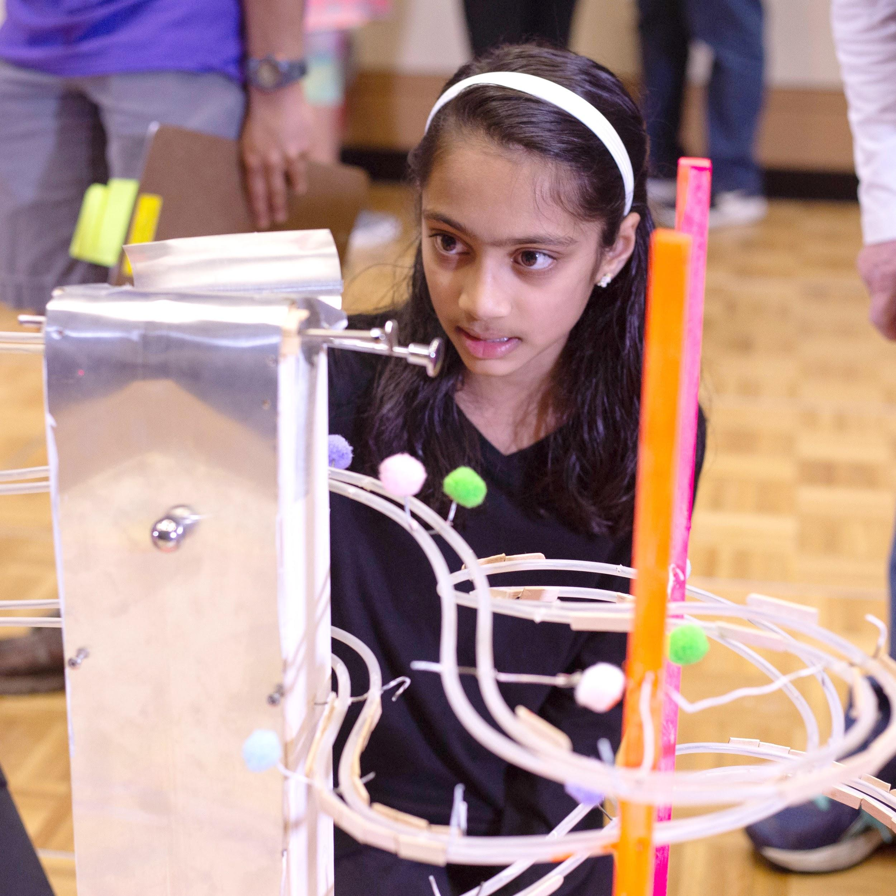
WHAT WE’VE ACCOMPLISHED
Our Challenge Solution
In this season’s Scientific Challenge, In Theory, our team was challenged to:
Produce a video presentation that tells a story about a Scientific Law that is bent and/or broken.
Show how the Scientific Law is bent and/or broken.
Include an expert and a witness in the story.
Use documentary techniques to tell the story in the style of a documentary film.
Create and present two Team Choice Elements that show off the team’s interests, skills, areas of strength, and talents.
Notes:
Modify this slide:
If this is your Challenge, replace a picture with a picture of your team in action.
If this is not your Challenge, delete the slide or hide it by right clicking on the slide and choosing delete or hide.
Tips for presenting this slide:
Give an overview of the Challenge components you were asked to include.
Highlight the knowledge areas you used (math, science, technology, engineering, script-writing, etc.).

Slide 10
WHAT WE’VE ACCOMPLISHED
Our Challenge Solution
In this season’s Engineering Challenge, Built to Last, our team was challenged to:
Research visual art styles and architecture styles.
Design and create a single three-dimensional physical model of a building.
Create a video presentation that tells a story about how opposites can be complementary.
Integrate your model of a building and a planning artifact into the video presentation.
Present part of the video presentation using a split screen to enhance the story.
Create and present two Team Choice Elements that show off your team’s interests, skills, areas of strength, and talents.
Notes:
Modify this slide:
If this is your Challenge, replace a picture with a picture of your team in action.
If this is not your Challenge, delete the slide or hide it by right clicking on the slide and choosing delete or hide.
Tips for presenting this slide:
Give an overview of the Challenge components you were asked to include.
Highlight the knowledge areas you used (math, science, technology, engineering, script-writing, etc.).

Slide 11
WHAT WE’VE ACCOMPLISHED
Our Challenge Solution
In this season’s Fine Arts Challenge, Epic Remix, our team was challenged to:
Research music videos and create a music video of your own.
Use music and lyrics to retell all or part of a piece of literature.
Design and build a costume.
Research production techniques to enhance the music video.
Create and present two Team Choice Elements that show off the team’s interests, skills, areas of strength, and talents.
Notes:
Modify this slide:
If this is your Challenge, replace a picture with a picture of your team in action.
If this is not your Challenge, delete the slide or hide it by right clicking on the slide and choosing delete or hide.
Tips for presenting this slide:
Give an overview of the Challenge components you were asked to include.
Highlight the knowledge areas you used (math, science, technology, engineering, script-writing, etc.).

Slide 12
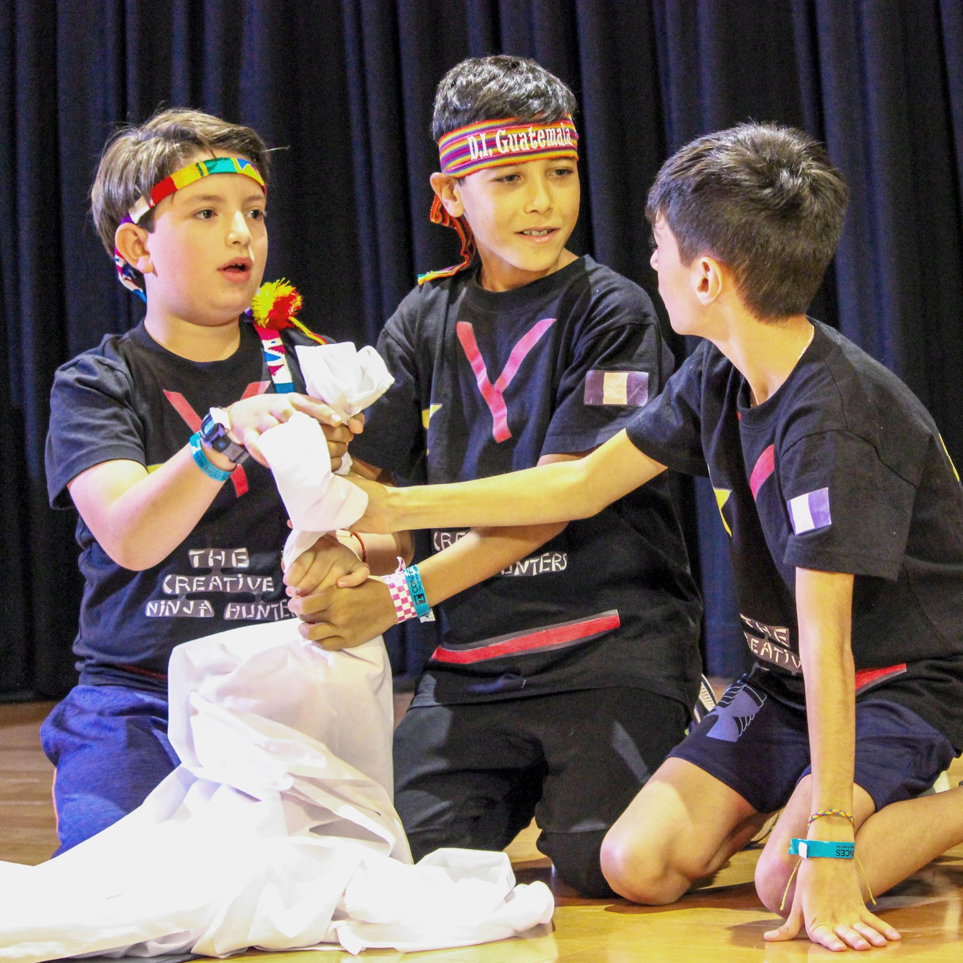
WHAT WE’VE ACCOMPLISHED
Our Challenge Solution
In this season’s Improvisational Challenge, Case Closed, our team was challenged to:
Research detectives and forensic techniques.
Create an improvisational video presentation that tells a story about a detective and a sidekick teaming up to solve a mystery.
Integrate a true clue and a red herring into the mystery.
Include the use of a forensic technique to help solve the mystery.
Notes:
Modify this slide:
If this is your Challenge, replace a picture with a picture of your team in action.
If this is not your Challenge, delete the slide or hide it by right clicking on the slide and choosing delete or hide.
Tips for presenting this slide:
Give an overview of the Challenge components you were asked to include.
Highlight the knowledge areas you used (math, science, technology, engineering, script-writing, etc.).

Slide 13
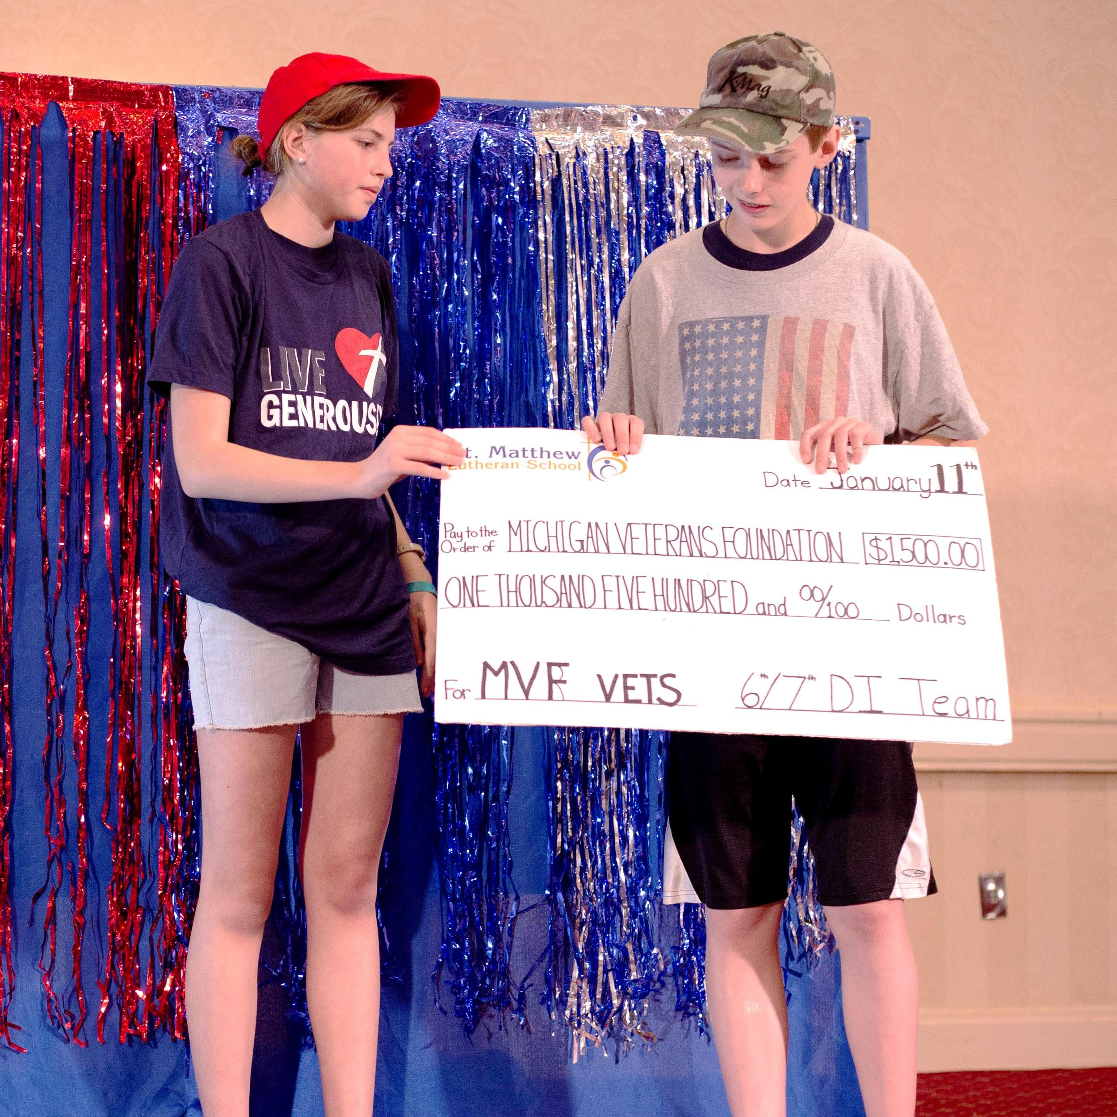
WHAT WE’VE ACCOMPLISHED
Our Challenge Solution
In this season’s Service Learning Challenge, Project Podcast, our team was challenged to:
Identify, design, carry out, and evaluate a project that addresses a need in a real community.
Create a video presentation that includes a podcast and a commercial.
Include a cliffhanger and a quirky character.
Integrate information about the project into the video presentation.
Create and present two Team Choice Elements that show off your team’s interests, skills, areas of strength, and talents.
Notes:
Modify this slide:
If this is your Challenge, replace a picture with a picture of your team in action.
If this is not your Challenge, delete the slide or hide it by right clicking on the slide and choosing delete or hide.
Tips for presenting this slide:
Give an overview of the Challenge components you were asked to include.
Highlight the knowledge areas you used (math, science, technology, engineering, script-writing, etc.).

Slide 14
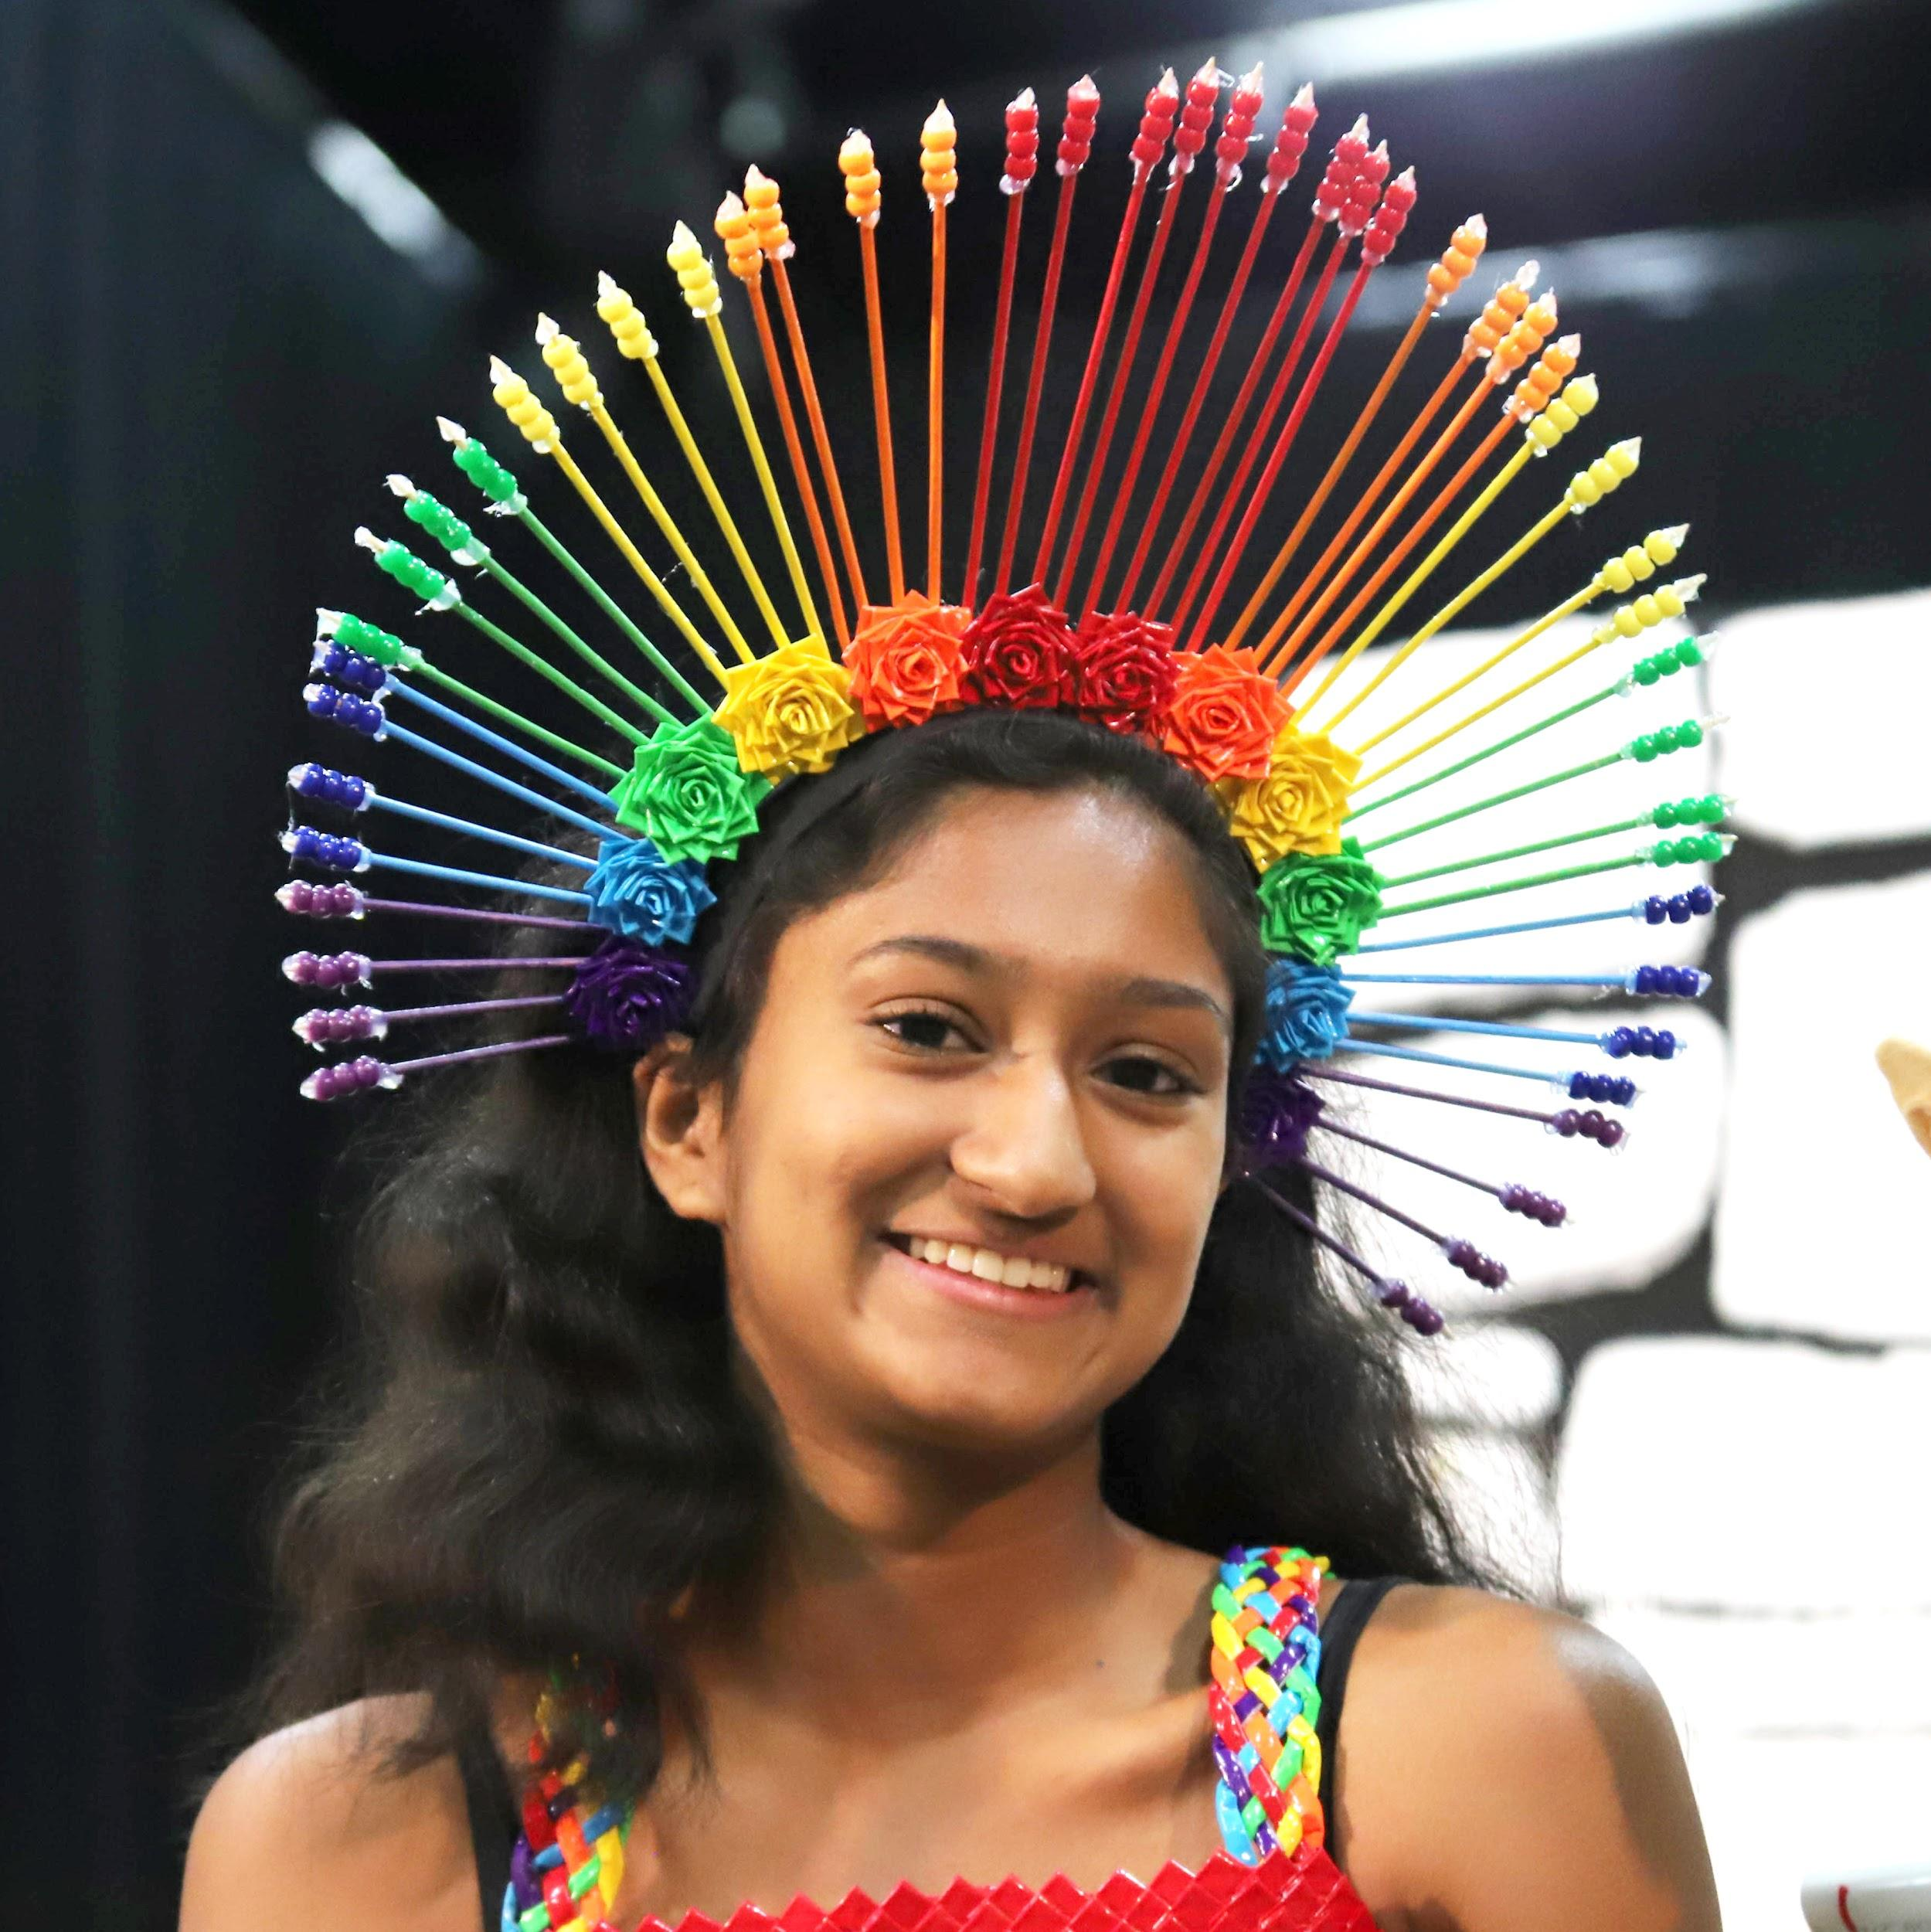
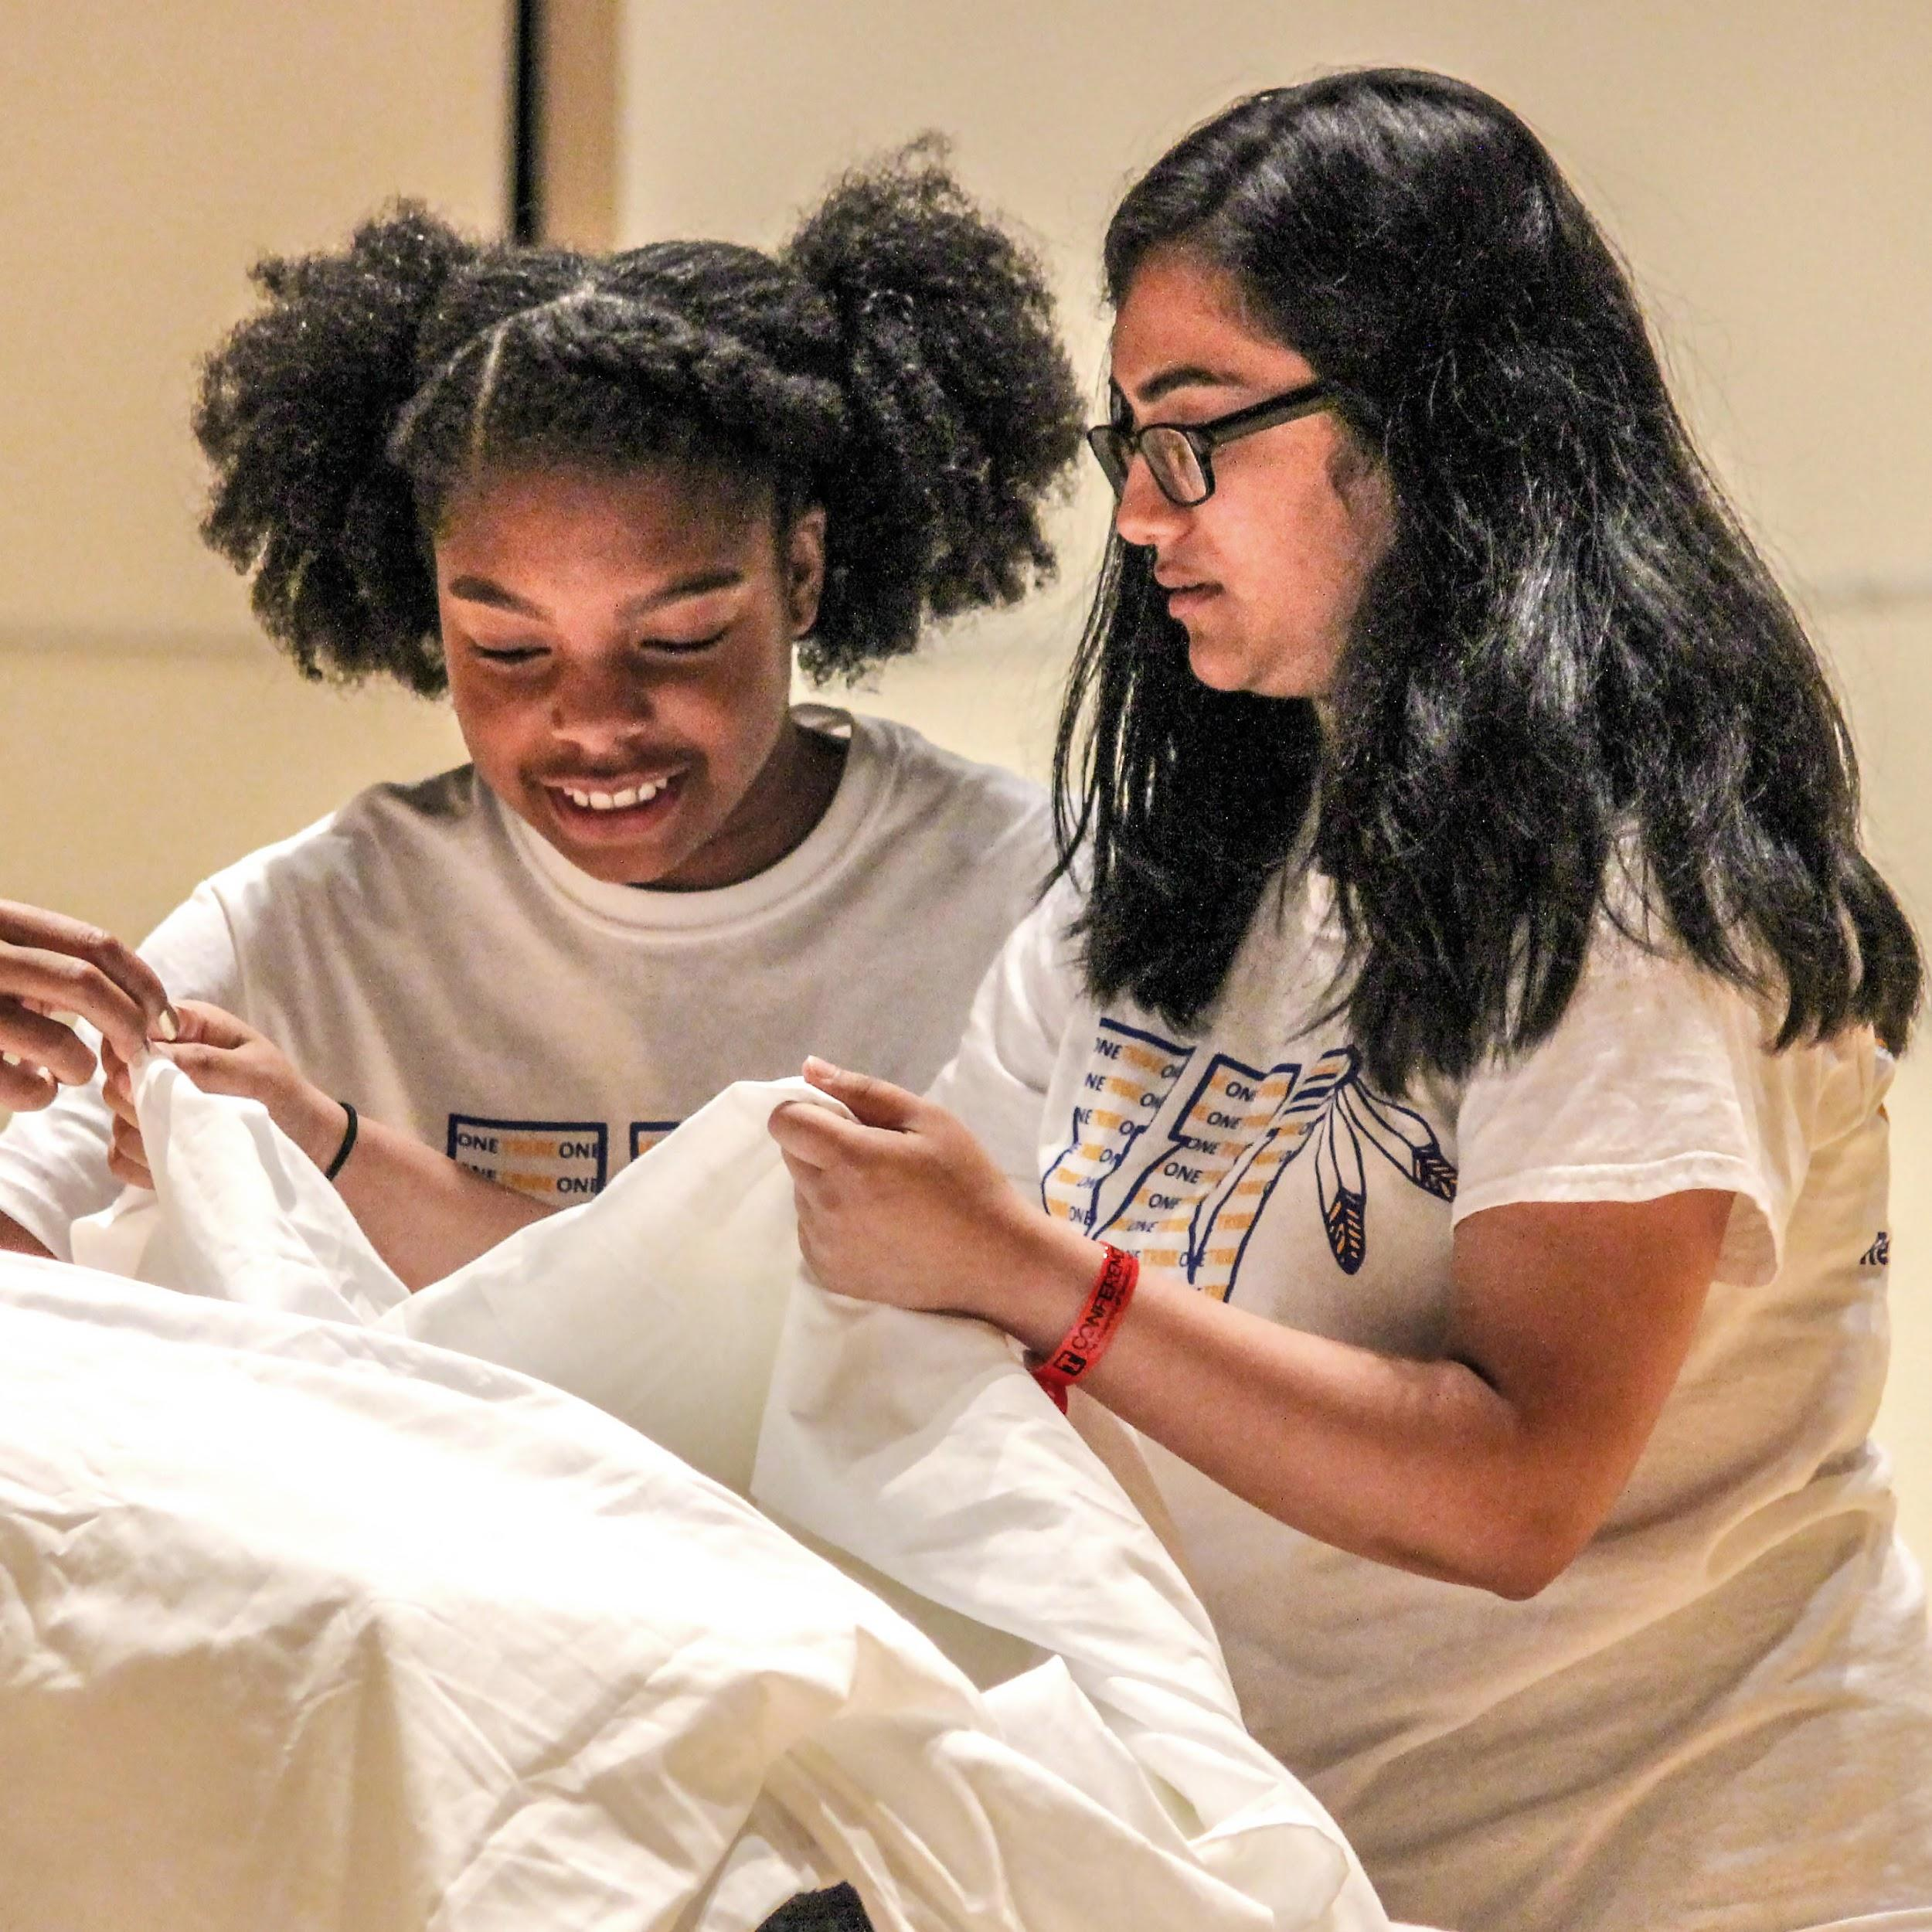

WHAT WE’VE ACCOMPLISHED
Our Creative Process
Describe your solution and add team photos
Notes:
Modify this slide:
Add in photos of your team during the season working on your solution or pictures of each of your props and a picture of your final solution.
Add text to the right describing your solution process, highlighting knowledge you applied and the creative process. Be specific.
Tips for presenting this slide:
Speak about what is happening in a few of the photos highlighting the skills you were practicing.

Slide 15
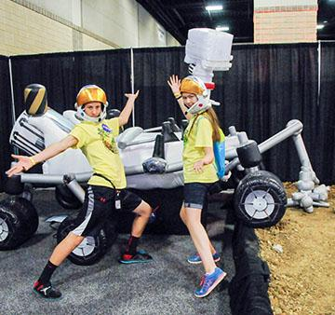


WHAT WE’VE ACCOMPLISHED
Our Skills and Knowledge
Skills
Knowledge
“
“
If every student had opportunities such as these made possible through DI, our children would undoubtedly be future-ready!”
Helen Soule, Former Executive Director at Partnership for 21st Century Learning
These students will be the ones that take the rockets NASA is working on now to destinations unknown.”
Tammy Rowan, NASA
Notes:
Modify this Slide:
Add in the knowledge you have gained in subject areas such as science, technology, language, engineering, etc. (ex. propulsion systems and their respective benefits, editing in Premiere Pro, structural integrity of laminates, evelop memorable characters, etc.)
Add in skills you have gained. (ex. Effective use of time, planning and task management, looking critically at problems, trying various solutions and measuring results, etc.)
Tips for presenting this slide:
One team member tells a team story of a moment during the season when your team applied part of the knowledge on the slide.

Slide 16
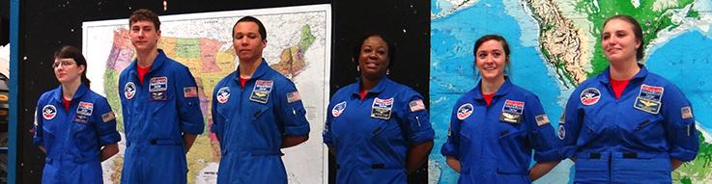
HOW YOU CAN HELP
Team Investment in DI
Our team has invested <fill in hours> hours over <fill in weeks> weeks developing our skills and solution.
LOCAL TEAM CHALLENGE COSTS
GLOBAL FINALS COSTS
Team Number Cost | $110
Materials for Solution | $
Travel to Tournament | $
Tournament Fees | $
Affiliate Fees | $
Total Invested:
Event/Hotel/Food | $5,500
Flight/Ground Transportation | $
Visa/Travel Insurance | $
Prop Shipment | $
T-shirts and Trading Pins | $
Total Needed:
Notes:
Modify the slide:
Replace <fill in hours> with the total amount of hours you met and worked individually on your Challenge solution.
Replace <fill in weeks> with the total amount of weeks you worked on your solution.
Replace the Local Team Challenge Costs with a picture of your team at the award ceremony.
Place the costs in your local currency.
Tips for filling in this slide:
Materials for Solution: Cost of materials on your Expense Report plus all other materials you used for development.
Travel to Tournament: petrol, bus, train, van costs that were spent.
Tournament Fees: What did you pay to attend the tournament? (Ask your Affiliate Director)
Affiliate Fees: What did you pay to participate in the program? (Ask your Affiliate Director)
Event/Hotel/Food: $5,500 USD for US teams or $5,000 USD for teams in countries requiring a visa for travel to US
Flight/ground transportation: Approximate costs for flight from your nearest airport to Kansas City plus taxi costs to hotel.
Visa/travel insurance: Check costs of visa or ESTA as needed by your country or province. Travel insurance can be purchased for around $10 USD per person. https://www.americanvisitorinsurance.com/
Prop Shipment: If you carry it in your suitcase, add at least 100USD per extra suitcase. If you ship, place the cost for shipping.
T-shirts and trading pins: Cost for t-shirts and pins (Ask your Affiliate Director)
Erase any rows that are not applicable to your team.
Tips for presenting this slide:
Highlight what you have invested already to participate locally.
Highlight the total needed focusing on the fact that your team is very dedicated to raising the money to have this experience.

Slide 17
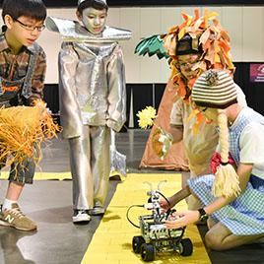

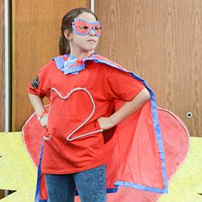
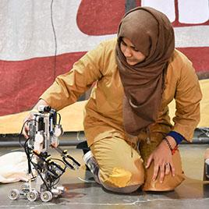
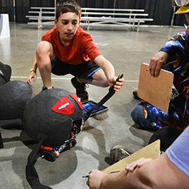
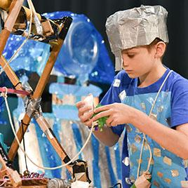
HOW YOU CAN HELP
Sponsorship Levels
By sponsoring our team, we will have the opportunity to represent our Affiliate and continue to develop top skills needed to prepare us to be employable and active citizens in our home country.
$2000
$4000
$7500
$10,000
$12,500
$15,000
Place benefits here.
Place benefits here.
Place benefits here.
Place benefits here.
Place benefits here.
Place benefits here.
Notes:
There are two potential layouts to ask for sponsorship, this slide and the next. Choose the one that makes the most sense in your culture to modify and present.
Erase or hide the slide you do not need.
Modify the slide:
Change the numbers based on your final goal. If your Total Needed from the last slide is 18,000, then place that number in the box at the far right and then work backwards through the boxes from right to left decreasing the amount by 2,500 or 3,000.
Place the numbers in your local currency if that works better for you.
Check the list of possible benefits to decide what you can offer the sponsor in return for their support. Feel free to add things not found on the list.
Sponsors often want to be able to share your story on their website to show people they support the community.
They also want the opportunity to get their company name and logo out to the public.
A higher amount should receive more benefits.
Benefits should increase from lowest sponsor level to highest.
Tips for presenting this slide:
Highlight what you can offer the company or person for their sponsorship dollars.
Focus on exposure of their brand and of their corporate social responsibility goals. (Exclusive interview video with the team about their experience, corporate logo on your t-shirts or bags, etc.)
Potential benefits:
Sponsor name on the GF website as a team donor for sponsorship above 10,000 USD. (reaches 78,000+ people)
Sponsor logo on the parade banner (check with the Affiliate Director for this) (reaches 10,000 people on livestream, 17,000 people in the arena)
Sponsor logo on the team t-shirt (17,000 people will attend the event)
Sponsor logo on the team booth (potential of 12,000 people visiting the booth)

Slide 18
HOW YOU CAN HELP
Sponsorship Levels
By sponsoring our team, we will have the opportunity to represent our Affiliate and continue to develop top skills needed to prepare us to be employable and active citizens in our home country.
Event Sponsor
Room & Board
Transportation
Visa & Insurance
Prop Shipment
T-shirts & Pins
$5,000 USD
Logo on t-shirts
$4,000 USD
$8,000 USD
$1,225 USD
$500 USD
$500
Notes:
Modify the slide:
Do your own calculations for transportation, visa and insurance, prop shipment, t-shirts and pins. If you do not need t-shirts and pins, then you can delete that section and move everything to the middle.
Insurance: https://www.americanvisitorinsurance.com/popular-traveler-global-destinations/#
Add benefits under each quantity.
Tips for presenting this slide:
Highlight what you can offer the company or person for their sponsorship dollars.
Focus on exposure of their brand and of their corporate social responsibility goals. (Exclusive interview video with the team about their experience, corporate logo on your t-shirts or bags, etc.)
Potential benefits:
Sponsor name on the GF website as a team donor for sponsorship above 10,000 USD. (reaches 78,000+ people)
Sponsor logo on the parade banner (check with the Affiliate Director for this) (reaches 10,000 people on livestream, 17,000 people in the arena)
Sponsor logo on the team t-shirt (17,000 people will attend the event)
Sponsor logo on the team booth (potential of 12000 people visiting the booth)

Slide 19

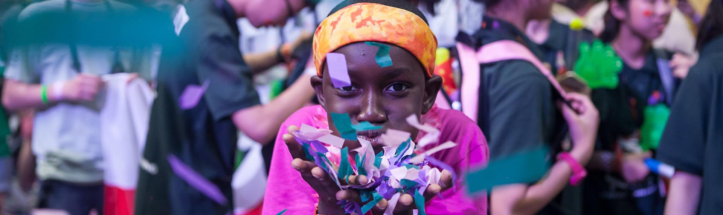



Thank you for investing in our future.
Team email
Team Phone
Local Affiliate website or DI website.
FACEBOOK
TWITTER
LINKEDIN
Notes:
Modify the slide:
Fill in your contact information: email and phone.
Fill in the website for your local Affiliate if there is one or use the DI website: www.destinationimagination.org
Change the links to social media to your local Affiliate if you wish or leave the DI social media links.
Tips for presenting this slide:
Thank them for their time and consideration.
Let them know when you will follow up with them to know their decision.

